Slide 1
Applications of Agent-Based Modelling
An implementation of agent-based modelling using NetLogo
George Hito
July 10th, 2015

Slide 2
Agenda
Intro
Basics and applications of ABM
Demo: Propagation of Opinions through a Communications Network
Additional/future work
Optimizing field agents
Discussion time

Slide 3
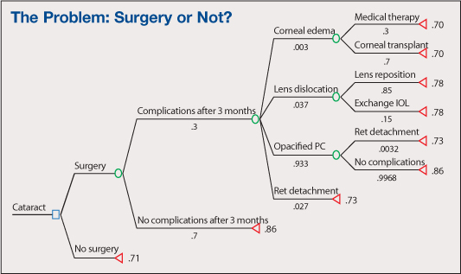
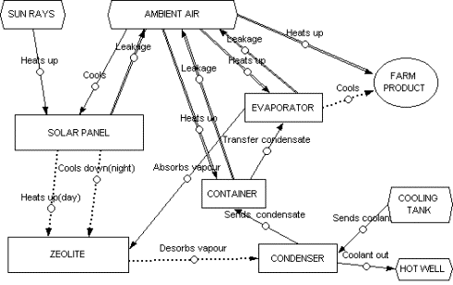
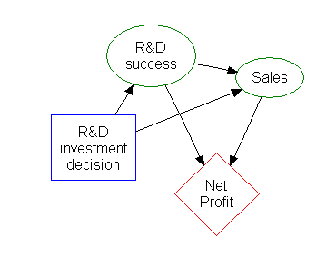
Modeling as a tool
Modeling is useful for simulating possible outcomes of some event or decision
Primarily used to display trends, too many variables for exact results to be pulled
Basic modeling methods include decision trees, influence diagrams, and function models

Slide 4
What is agent-based modeling?
A form of simulation founded on object-oriented programming
‘Agents’ are equivalent to objects, storing attributes and behaviors as internalized variables and methods.
Complex adaptive systems approach over the Newtonian approach
Mechanistic (i.e. the solar system) vs. irreversible (i.e. growth of an organism)
Pseudo-free-will
**Applications of ABM to be demonstrated at the end of the presentation

Slide 5
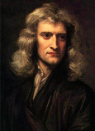

Mechanistic vs. complex adaptive
Two primary types of system models
Mechanistic: systems repeat themselves over time and are predictable from the top-down.
Complex adaptive: system behavior is defined only at the individual level. All large-scale behavior and phenomena occur as a result of interactions between individuals.
Notes:
The Newtonian approach assumes that a system can be described as a clock, and that it repeats specific behaviors in cycles (i.e. the solar system). Time can be reversed or accelerated and a pattern of behavior emerges – these systems function like clocks.
Complex adaptive systems are fundamentally opposite – they assume that there is no predictability of the full trajectory of the system. These function not like clocks but like a flock of birds, constantly adjusting to changing contexts.

Slide 6
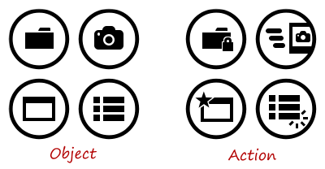
The object-oriented approach related to ABM
Procedure = list of instructions (verbs)
Object = list of attributes (adjectives) that describe some encompassing entity (noun)
Primary abstraction = main ‘building block’ of the language
Procedural languages treat functions as the primary abstractions – there is a list of instructions that can be called and algorithms are built directly from that
Object oriented languages treat objects as the primary abstractions – procedures are contained within methods, but the main focus is on manipulating objects

Slide 7
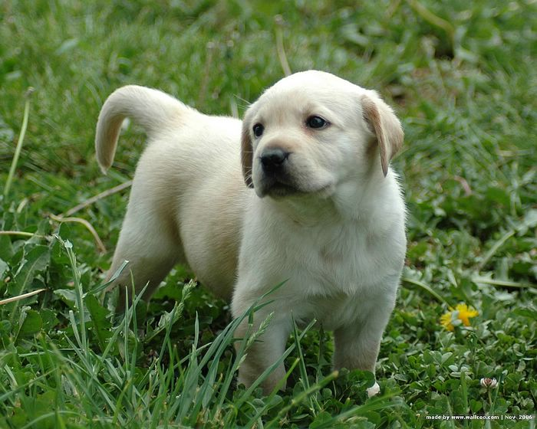



What is an agent and how do they act?

Slide 8


Foundations of agent-based modeling
Unpredictable
systems
Agent-based modeling
Object-oriented approach

Slide 9
How is it useful?
Powerful tool for simulating countless iterations of any system of behaviors in order to pick out patterns and trends.
Can simulate the various outcomes of a decision and how they affect a system over time
If a user posts an opinion towards a medicine in a network, we can chart how the information propagates over time to other users.
ABM =/= Discrete event simulation

Slide 10

What are its drawbacks?
Real-world situations aren’t wholly mechanistic
Models require a large amount of processing power

Slide 11

What are we trying to model?
Say a patient has an experience with a drug (good or bad) and posts about it online. What factors affect how quickly that information spreads?
Fame/influence of the initial user
Intensity of the initial opinion
Size of the initial information hub it is passed to
General structure and size of the network
User-hub ratio
NetLogo logo

Slide 12
Elements of the network
Network users (squares)
Store an ‘opinion’ and ‘fame’ value. The fame is preset on setup.
Custom fame and opinion per user can be set before running a simulation.
Color gradient allows for easy visual identification of current opinion value.
Information hubs (circles)
Store an ‘opinion’ value.
Change in size based on how ‘connected’ they are in the network (how many users and other hubs are connected to them), reflecting their influence.
Also includes a color gradient.
Data links (lines)
Transfer some amount of ‘opinion’ between agents on every tick of the simulation.

Slide 13
Elements of the network (cont.)
Users can only communicate to other users through hubs, so there only exist links between hubs/hubs and between users/hubs.
Every hub and user ‘sends’ some portion of its total opinion to its neighbors with every ‘tick’ of the simulation.
There exists a ‘forgetfulness’ factor that decreases the magnitude of the opinion of each agent by a small amount every tick.
Virtually everything is customizable by the user.

Slide 14
Questions we can answer (sample situations)
If a person has a near-death experience with a drug due to unforseen side effects, how much time and resources will we need to placate the public?
How can positive experiences balance negative ones in terms of overall opinion change?
How does the overall network response to a minor event compare to the response to a major event?
How does forgetfulness affect the opinion change over time?

Slide 15
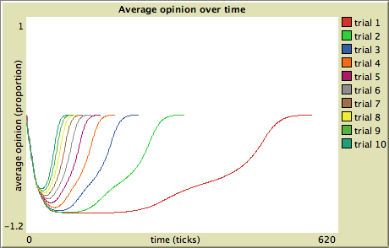
Adjusting only forgetfulness
Smaller values result in longer simulations
Adjusting forgetfulness can show you how the network structure affects opinion travel – the hills and bends towards the end should correspond in some way to how the nodes are laid out.

Slide 16
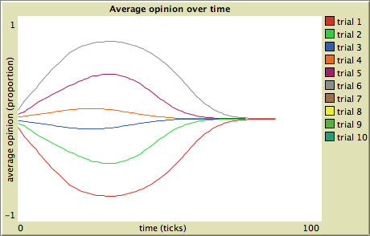
Adjusting only the initial event intensity
The largest amplitude curves correspond to death and a fully treated condition, the next largest correspond to major negative/positive side effects, and the smallest correspond to minor negative/positive effects.

Slide 17
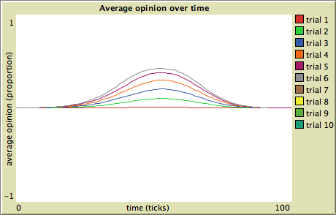
Adjusting only the source user’s fame
-The smallest amplitude curve corresponds to a user-fame value of 1, while the largest one corresponds to a user-fame value of 50. Values in between are multiples of 10.

